Slide 1
FUNDING OPPORTUNITIES FOR LOCAL WINE MAKERS
Presentation to Wine Webinar
08 December 2021
^{Ts’episo Makgothi}
^{Chief Director: SP & CC}
^{Industrial Financing}

Slide 2
CONTENT
Introduction
Macro-economic statistics of the Wine Industry
Possible Government Interventions
Agro-Processing Support Scheme (APSS)
Export Marketing and Investment Assistance (EMIA)
Sector Specific Assistance Scheme (SSAS)
Critical Infrastructure Programme (CIP)
Non-financial Support
Application Process
Contact Details

Slide 3
INTRODUCTION
The South African (SA) wine industry: an important component of both the agricultural and agro-processing value chains.
The industry is primarily located in the Western Cape more especially in the rural part of the province. it is a labour intensive sector therefore it play a pivotal role in terms of both rural industrialization and development.
Whilst the wine sector is important in economic terms, it is struggling to contribute to Government’s transformation imperatives. Apart from two to three high-profile BEE transactions (which have typically not been broad-based) involving large, established wineries, the sector has performed relatively poorly in that score card.
The industry consists of :
2693 primary producers,
529 cellars,
45 co-operatives,
22 producing wholesalers and
about 17 black vintners.

Slide 4
MACRO-ECONOMIC STATISTICS
At the end of the 2020 harvest, South Africa produced about 1.340 million tones of grapes, about 86% of which was processed into wine/s that yielded an estimate of 317 million litres.
South Africa is the 8th largest producer of wines accounting for about 4% of the world output after Italy (18.3%), France (17%) and Spain (13.2%).
South Africa’s wines are predominantly sold in the European market with the UK as the number one importer followed by the Netherlands, Germany and Sweden. Other markets outside Europe include the USA, Canada, Russia, China and African countries.
The value-chain including both grape farming and wine production contributes approximately R55bn to national GDP and provides employment to about 270 000 people. Of these job opportunities, 160 000 are for unskilled workers in rural areas.

Slide 5
POSSIBLE GOVERNMENT INTERVENTIONS
Financial Support:
APSS
EMIA
SSAS
CIP
Non-Financial Support:
Trade Negotiations with Asian countries for Market Access.

Slide 6
AGRO-PROCESSING SUPPORT SCHEME (APSS)
Agro-Processing Support Scheme (APSS) aims to stimulate investment by South African agro-processing / beneficiation enterprises. Investments should demonstrate that they will achieve:
Increased capacity;
Employment creation;
Modernised machinery and equipment;
Competitiveness and productivity improvement;
Broadening participation;

Slide 7
AGRO-PROCESSING SUPPORT SCHEME (cont.)
20% to 30% cost sharing grant to a maximum of R20 m, over a two-year investment period.
Type of Applicant | Historical cost of assets | Qualifying Investment costs | Grant Percentage | Maximum grant amount
New Entity | N/A | R1m to R10m | 30% | R3 m
Existing Entity | ≤ R 10 m | R1m to R10m | 30% | R3 m
New Entity | N/A | > R 10 m | 20% | R20 m
Existing Entity | > R 10 m | > R10 m | 20% | R20 m

Slide 8
AGRO-PROCESSING SUPPORT SCHEME (cont.)
New machinery, equipment, tools and Forklifts;
New commercial vehicles;
Buildings;
Competitiveness improvement interventions.

Slide 9
AGRO-PROCESSING SUPPORT SCHEME (cont.)
Registered Legal entity and Taxpayer in good standing
Involvement in new Agro-processing / beneficiation operation or in expanding or upgrading of existing operation;
B-BBEE compliant (achieve levels 1 to 4) & submit valid B-BBEE certificate of compliance;
Project to boost local capacity of identified product (s);
Adherence to minimum wage & legislative requirements governing the sector;
Demonstrate that 50% of inputs will be sourced from SA suppliers & at least 30% of inputs to be sourced from black South Africans, otherwise motivation required;
Commencement date of project / activities applied for – within 90 calendar days after approval of application.
Undertake an investment project which should result in retaining or creating direct employment;
Any assets bought or taken into commercial use or competitiveness improvement costs incurred before applying for the incentive, will be considered non-qualifying.

Slide 10
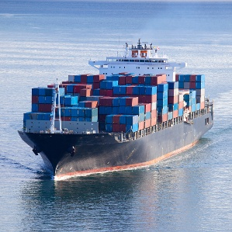
EXPORT MARKETING AND INVESTMENT ASSISTANCE (EMIA)
AIM: To support exporters to explore export Markets
Individual Exhibition Participation | Primary Market Research & Foreign Direct Investment | Individual Inward Missions | Group Missions and National Pavillions
Return airfare Subsistence allowance Transportation of samples Exhibition costs | Return airfare Subsistence allowance Transportation of samples Patents Production of marketing material | Return airfare Subsistence allowance Car rental | Selected Trade Fairs & Exhibitions / Export Councils, Industry Associations & Provincial Trade Promotion Agencies Return airfare Subsistence allowance Transportation of samples Exhibition costs

Slide 11
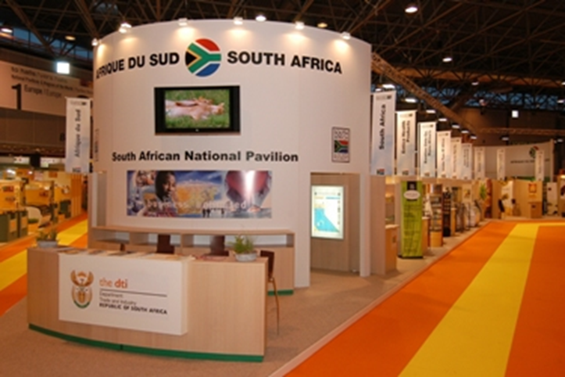
SECTOR SPECIFIC ASSISTANCE SCHEME (SSAS)
A reimbursable cost-sharing incentive scheme whereby financial support is granted to organisations supporting the development of industry sectors and those contributing to the growth of South African exports.
Organisations supported under include:
Export Councils,
Joint Action Groups,
Industry Associations and
Organisations involved in the development of emerging exporters.
SSAS/Project Funding - A reimbursable 80:20 cost-sharing grant scheme
SSAS/Emerging Exporters -100% of the cost to a maximum of R1, 9 million per project

Slide 12
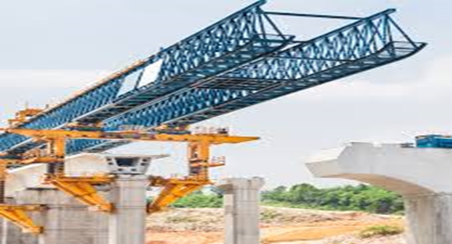
CRITICAL INFRASTRUCTURE PROGRAMME (CIP)
Registered private entities and local governments (municipalities, excluding metropolitan municipalities)
Types of supported projects: capped at R50m
Strategic Infrastructure Feasibility Studies – 60:40 of total qualifying studies costs and 80:20 (inside SEZs)
Generic Investment - 10% to 30% of total qualifying infrastructural development costs capped
SA Film and TV Studios and Cinemas – 30:70 cost sharing for SA owned film & television studios and cinemas
State Owned Testing Facilities - 50:50 cost sharing of total qualifying infrastructural development costs
State owned Industrial Parks - 100% of total qualifying infrastructural development costs
Distressed Municipalities or Investors in such Municipalities: 15-100% of
total qualifying infrastructural development costs up to
R50m; 100% support towards strategic infrastructure
studies, capped at R10m

Slide 13
APPLICATION PROCESS
Application:
Applicant obtains incentive application form and guidelines from the dti website (www.thedtic.gov.za) under Financial Assistance tab;
Applicant may obtain further information telephonically, by e-mail or visit to the dti offices.
The guideline should be read before completing the application form.
The Applicant e-mails the completed, signed application form with supporting documents to the dedicated email address;
Basic Evaluation:
The application is allocated to a processor for assessing its completeness
The applicant will receive an acknowledgement letter from the Programme Administration;
The review of the documents is undertaken and should all documents be in place, the application is sent for further processing and prepared for adjudication;
If the application has outstanding documents, then the applicant is contacted and provided with a timeframe within which to provide the outstanding information
Adjudication:
Technical evaluation will be performed for the complete applications;
Adjudication Committee convenes to assess the application - Applications are approved, rejected or referred back for additional information.
The decision of the Adjudication Committee is final.
Letter confirming approval of the application and the claim form will be forwarded to the applicant within a specified timeframe.

Slide 14
CONTACT DETAILS
E-mail: incentives@thedti.gov.za
Telephone: 012 394 1255
Customer Contact Centre: 0861 843 384
website: www.thedtic.gov.za (Financial Assistance)

Slide 15
THANK YOU

